Slide 1






Visualizing Sets and Set-typed Data: State-of-the-Art and Future Challenges
Bilal
Alsallakh
Luana
Micallef
Wolfgang
Aigner
Helwig
Hauser
Silvia
Miksch
Peter
Rodgers

Slide 2
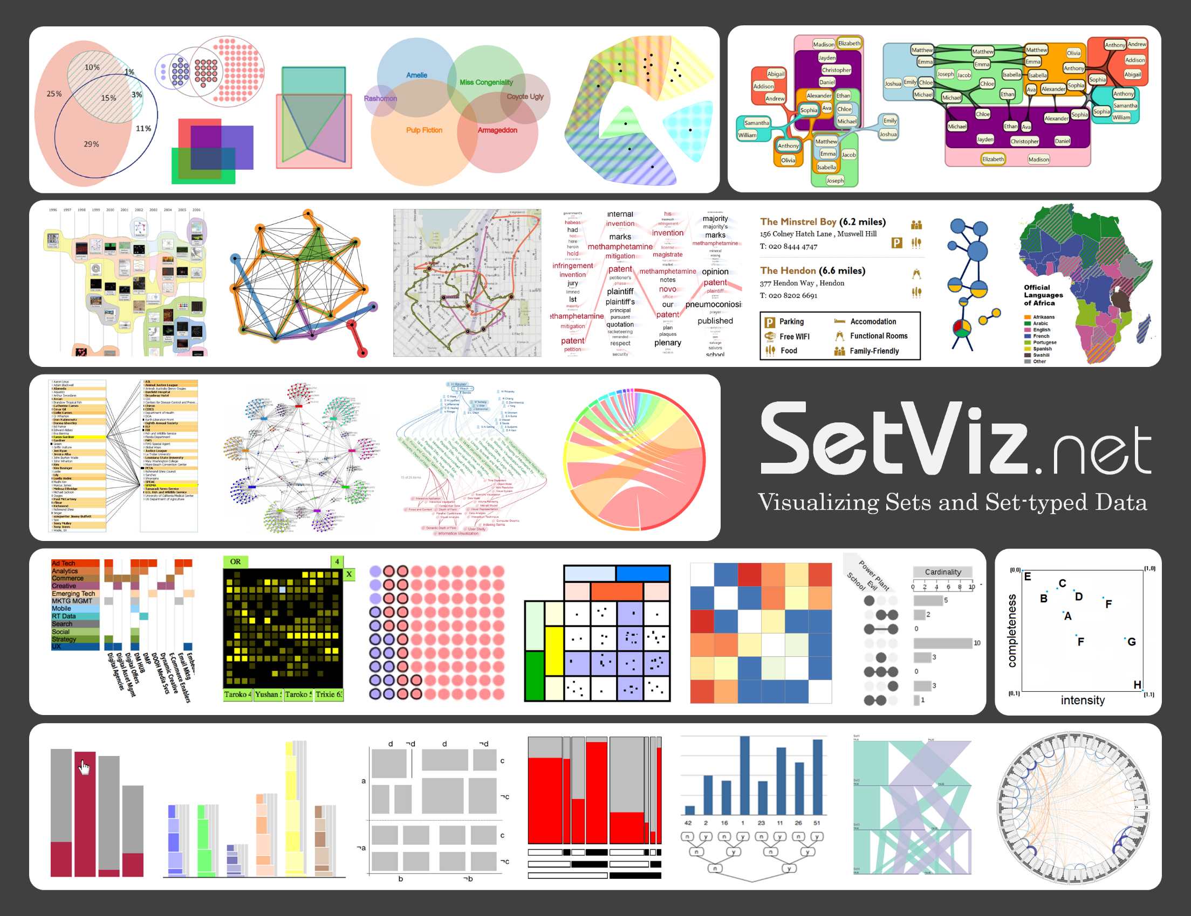

Slide 3











Bilal Alsallakh Luana Micallef Wolfgang Aigner Helwig Hauser Silvia Miksch Peter Rodgers
Author | Sex M F M M F M | PhD 9999 2014 2006 1998 1990 1997 | Affiliation | Topics InfoVis; VA; Biology; Machine Learning InfoVis; Diagrams; Visual Languages InfoVis; VA; Time; Science of Interaction IVA; SciVis; InfoVis; Biology InfoVis; VA; Process Management; Time Diagrams; Logic; Visual Languages

Slide 4
Author | Sex M F M M F M | PhD 9999 2014 2006 1998 1990 1997 | 1 0 1 0 1 0 | 0 1 0 0 0 0 | 0 1 0 0 0 1 | 0 0 1 0 0 0 | 0 0 0 1 0 0 | Topics InfoVis; VA; Biology; Machine Learning InfoVis; Diagrams; Visual Languages InfoVis; VA; Time; Science of Interaction IVA; SciVis; InfoVis; Biology InfoVis; VA; Process Management; Time Diagrams; Logic; Visual Languages

Slide 5
Author | Sex M F M M F M | PhD 9999 2014 2006 1998 1990 1997 |  |  |  |  |  | Topics InfoVis; VA; Biology; Machine Learning InfoVis; Diagrams; Visual Languages InfoVis; VA; Time; Science of Interaction IVA; SciVis; InfoVis; Biology InfoVis; VA; Process Management; Time Diagrams; Logic; Visual Languages

Slide 6
Science of Interaction
Machine Learning
VA
IVA
Biology
Time
SciVis
InfoVis
Process Management
Diagrams
Visual Languages
Logic

Slide 7
Author | Sex M F M M F M | PhD 9999 2014 2006 1998 1990 1997 | 1 1 1 | 1 | 1 1 | 1 | 1 | Topics InfoVis; VA; Biology; Machine Learning InfoVis; Diagrams; Visual Languages InfoVis; VA; Time; Science of Interaction IVA; SciVis; InfoVis; Biology InfoVis; VA; Process Management; Time Diagrams; Logic; Visual Languages

Slide 8
Set-typed Data
Sex | PhD
M F M M F M | 9999 2014 2006 1998 1990 1997
Elements
Sets
Set System
Elements
Sets
Memberships
Element Attributes
Set Relations
Inclusion
Exclusion
Intersection

Slide 9
Special Cases
Categorical Data
Exclusion relations only
Partioning / grouping
 | Mother Tongue AR MT DE DE DE EN | Sex M F M M F M
M
F

Slide 10
Special Cases
Hierarchies
Inclusion and exclusion relations only

Slide 11

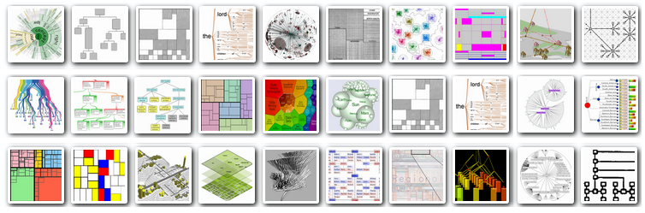

Scope of the STAR
at least one intersection
www.treevis.net
All set systems

Slide 12
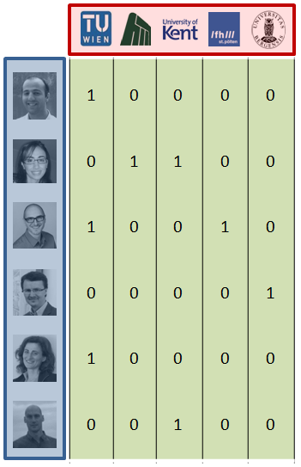
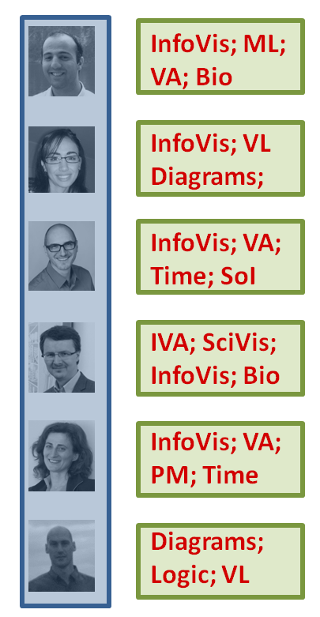
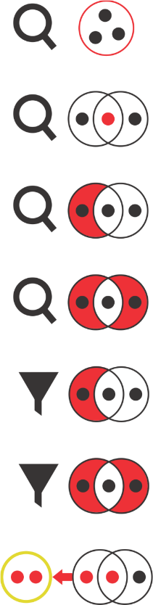
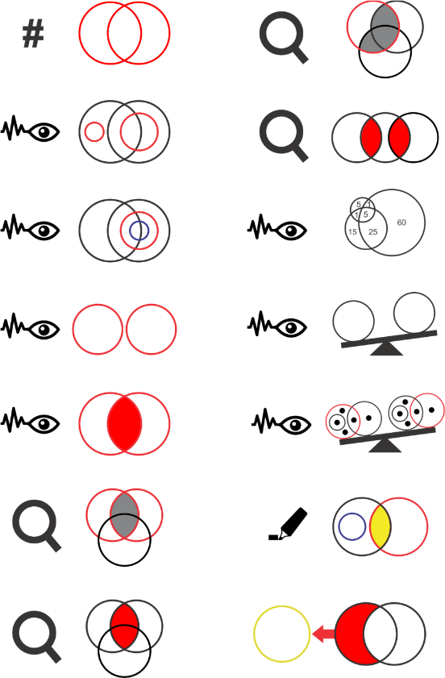
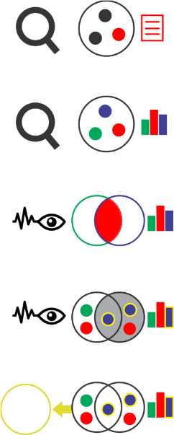


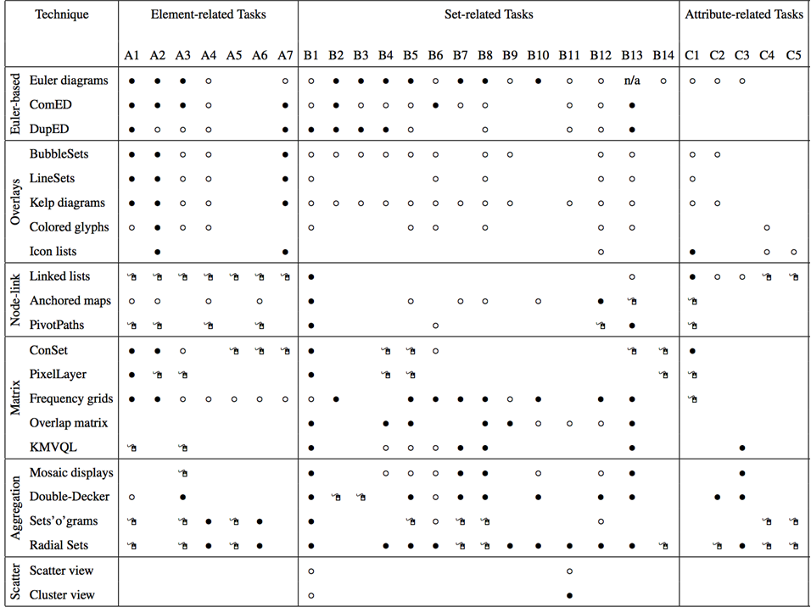

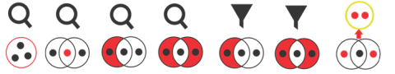
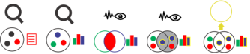
Content
Sets as a data type
Tasks with set-typed data
Visualization techniques
Comparison
Future challenges
Why to think of sets

Slide 13
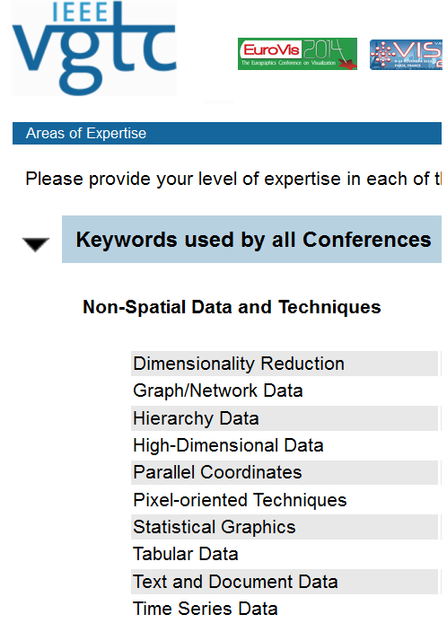
Sets as a Data Type
Uncommon in InfoVis
Unlike Graphs, Trees, etc.
Often treated as
Categorical attributes
Boolean attributes
Often used for grouping
Not as primary objects

Slide 14
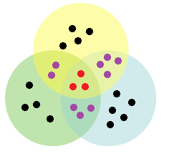
Set-typed Data - Characteristics
Set Algebra
Set operations, Cartesian product, power set, ...
Set similarities
Similarity measures (Jaccard, Tversky, etc.)
Element degree
exclusive set membership
Dimensionality
2^n possible combinations
2^(2^n) possible queries

Slide 15
Set-typed Data - Representations
Different forms
Boolean Attributes
Multi-valued Attribute
Element-Set Tuples
Adjacency Matrix
Adjacency List
Edge List

Slide 16
Relation to Hypergraphs
Equivalent to a Set System

Slide 17
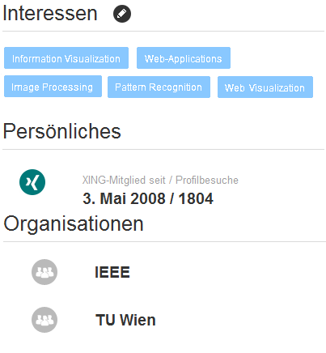

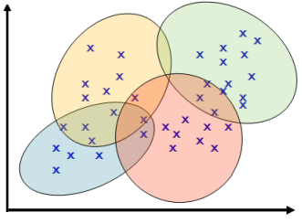
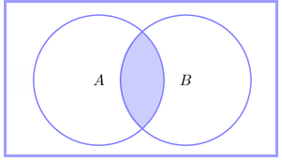
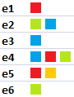
Where do sets come from?
Tags
Queries
Subscriptions, votings, surveys
Probablistic events
Fuzzy clustering
Multi-label classifications

Slide 18
Tasks

Slide 19

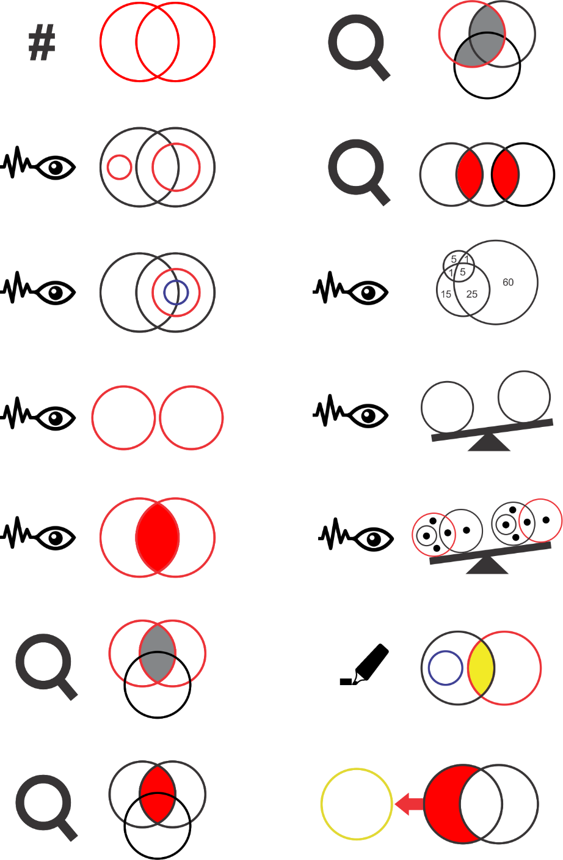
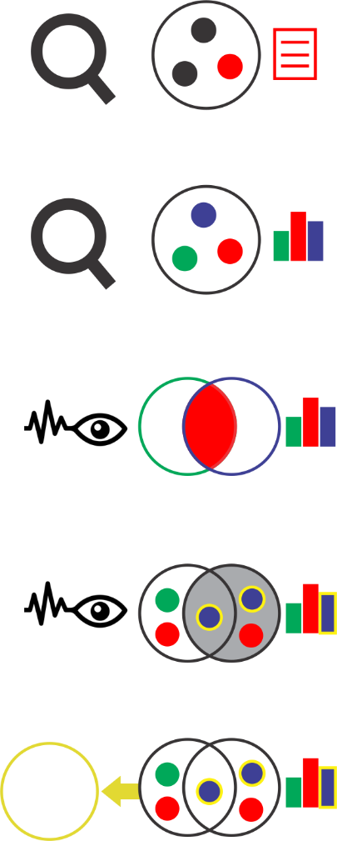
Elements
Sets and Set Relations
Element Attributes

Slide 20
Elements
Sets and Set Relations
Element Attributes

Slide 21
Elements
Find elements belonging to a specific set
Find sets containing a specific element
Find elements based on their set memberships
Find elements with a specific set membership degree
Filter out elements based on their set memberships
Filter out elements based on their set membership degrees
Create a new set that contains certain elements

Slide 22
Elements
Find elements belonging to a specific set
Find sets containing a specific element
Find elements based on their set memberships
Find elements with a specific set membership degree
Filter out elements based on their set memberships
Filter out elements based on their set membership degrees
Create a new set that contains certain elements

Slide 23






Elements
Find elements belonging to a specific set
Find sets containing a specific element
Find elements based on their set memberships
Find elements with a specific set membership degree
Vienna University of Technology
Filter out elements based on their set memberships
Filter out elements based on their set membership degrees
Create a new set that contains certain elements

Slide 24

Elements
Find elements belonging to
a specific set
a specific set
Vienna University of Technology

Slide 25

Elements
Find sets containing
a specific element
a specific element
affiliations
Vienna University of Technology

Slide 26



Elements
set memberships
Find elements based on their
set memberships
Vienna University of Technology

Slide 27
Elements
Find elements with
a specific set membership degree
a specific set membership degree
Vienna University of Technology
2 affiliations

Slide 28
Elements
Find elements belonging to a specific set
Find sets containing a specific element
Find elements based on their set memberships
Find elements with a specific set membership degree
Vienna University of Technology
Filter out elements based on their set memberships
Filter out elements based on their set membership degrees
Create a new set that contains certain elements

Slide 29
Elements
Sets and Set Relations
Element Attributes

Slide 30
Elements
Sets and Set Relations
Element Attributes

Slide 31
Sets and Set Relations
Find the # of sets
in the set family
Find set intersections
of a specific set
Analyze
inclusion relations
Find the set with largest
pairwise set intersections
Analyze
inclusion hierarchies
Analyze set & set
intersection cardinalities
Analyze
exclusion relations
Analyze and compare
set similarities
Analyze
intersection relations
Analyze and compare
set exclusiveness
Find intersections
between k sets
Highlight specific sets,
subsets, or set relations
Find sets involved in
certain intersection
Create a new set using
set-theoretical operations

Slide 32
Sets and Set Relations
Find the # of sets
in the set family
Find set intersections
of a specific set
Analyze
inclusion relations
Find the set with largest
pairwise set intersections
Analyze
inclusion hierarchies
Analyze set & set
intersection cardinalities
Analyze
exclusion relations
Analyze and compare
set similarities
Analyze
intersection relations
Analyze and compare
set exclusiveness
Find intersections
between k sets
Highlight specific sets,
subsets, or set relations
Find sets involved in
certain intersection
Create a new set using
set-theoretical operations

Slide 33
Sets and Set Relations
Vienna University of Technology
Find the # of sets
in the set family
Find set intersections
of a specific set
Vienna University of Technology
Analyze
inclusion relations
Find the set with largest
pairwise set intersections
Analyze
inclusion hierarchies
Analyze set & set
intersection cardinalities
Vienna University of Technology
Analyze
exclusion relations
Analyze and compare
set similarities
Analyze
intersection relations
Analyze and compare
set exclusiveness
Vienna University of Technology
Find intersections
between k sets
Highlight specific sets,
subsets, or set relations
InfoVis
Visual Analytics
Time-oriented Data
Diagrams
Find sets involved in
certain intersection
Create a new set using
set-theoretical operations

Slide 34
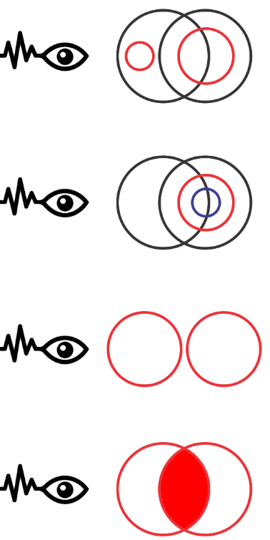







Sets and Set Relations
Analyze
inclusion relations
Analyze
inclusion hierarchies
Analyze set & set
intersection cardinalities
Analyze
exclusion relations
InfoVis
Analyze
intersection relations
Diagrams
VA
TD
InfoVis
Visual Analytics (VA)
Time-oriented Data (TD)
Diagrams

Slide 35
Sets and Set Relations
Analyze
inclusion relations
InfoVis
v
Diagrams
VA
TD
InfoVis
Visual Analytics (VA)
Time-oriented Data (TD)
Diagrams

Slide 36
Sets and Set Relations
Analyze
inclusion hierarchies
InfoVis
v
Diagrams
VA
TD
InfoVis
Visual Analytics (VA)
Time-oriented Data (TD)
Diagrams

Slide 37
Sets and Set Relations
Analyze
exclusion relations
InfoVis
v
Diagrams
VA
TD
InfoVis
Visual Analytics (VA)
Time-oriented Data (TD)
Diagrams

Slide 38
Sets and Set Relations
Analyze
intersection relations
InfoVis
Diagrams
VA
TD
InfoVis
Visual Analytics (VA)
Time-oriented Data (TD)
Diagrams

Slide 39
Sets and Set Relations
Analyze set & set
intersection cardinalities
InfoVis
1
Diagrams
VA
1
1
1
TD
InfoVis
Visual Analytics (VA)
Time-oriented Data (TD)
Diagrams
2

Slide 40
Sets and Set Relations
Vienna University of Technology
Find the # of sets
in the set family
Find set intersections
of a specific set
Vienna University of Technology
Analyze
inclusion relations
Find the set with largest
pairwise set intersections
Analyze
inclusion hierarchies
Analyze set & set
intersection cardinalities
Vienna University of Technology
Analyze
exclusion relations
Analyze and compare
set similarities
Analyze
intersection relations
Analyze and compare
set exclusiveness
Vienna University of Technology
Find intersections
between k sets
Highlight specific sets,
subsets, or set relations
Find sets involved in
certain intersection
Create a new set using
set-theoretical operations

Slide 41
Elements
Sets and Set Relations
Element Attributes

Slide 42
Elements
Sets and Set Relations
Element Attributes

Slide 43

Element Attributes
Find the attribute value of a certain element
Find the distribution of an attribute in a certain set or subset
Compare the attribute values of sets or set intersections
Analyze the set memberships for elements having
certain attribute values
Create a new set out of elements having
certain attribute values
age

Slide 44
Element Attributes
Find the attribute value of a certain element
Find the distribution of an attribute in a certain set or subset
Compare the attribute values of sets or set intersections
Analyze the set memberships for elements having
certain attribute values
Create a new set out of elements having
certain attribute values
gender
4
2
F
M

Slide 45
Element Attributes
Find the attribute value of a certain element
Find the distribution of an attribute in a certain set or subset
Compare the attribute values of sets or set intersections
Analyze the set memberships for elements having
certain attribute values
Create a new set out of elements having
certain attribute values

Slide 46

Element Attributes
Analyze the set memberships for elements having
certain attribute values
set memberships = research areas
elements = authors
attribute value = female
InfoVis
Diagrams
VA
TD
InfoVis
Visual Analytics (VA)
Time-oriented Data (TD)
Diagrams

Slide 47
Elements
Sets and Set Relations
Element Attributes

Slide 48
Elements
Sets and Set Relations
Element Attributes

Slide 49
?
Questions

Slide 50
Survey

Slide 51


Slide 54
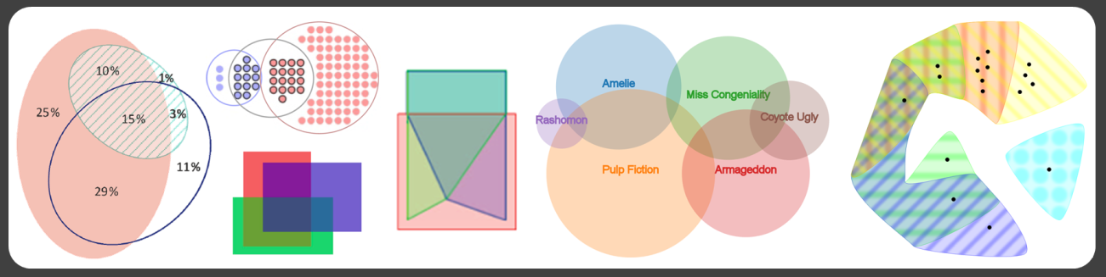
1 Euler and Venn Diagrams

Slide 55






Euler Diagram
exclusion
InfoVis
Diagrams
VA
ToD
inclusion
intersection
InfoVis
Visual Analytics (VA)
Time-oriented Data (ToD)
Diagrams

Slide 56
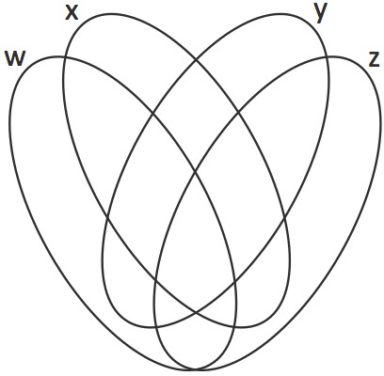
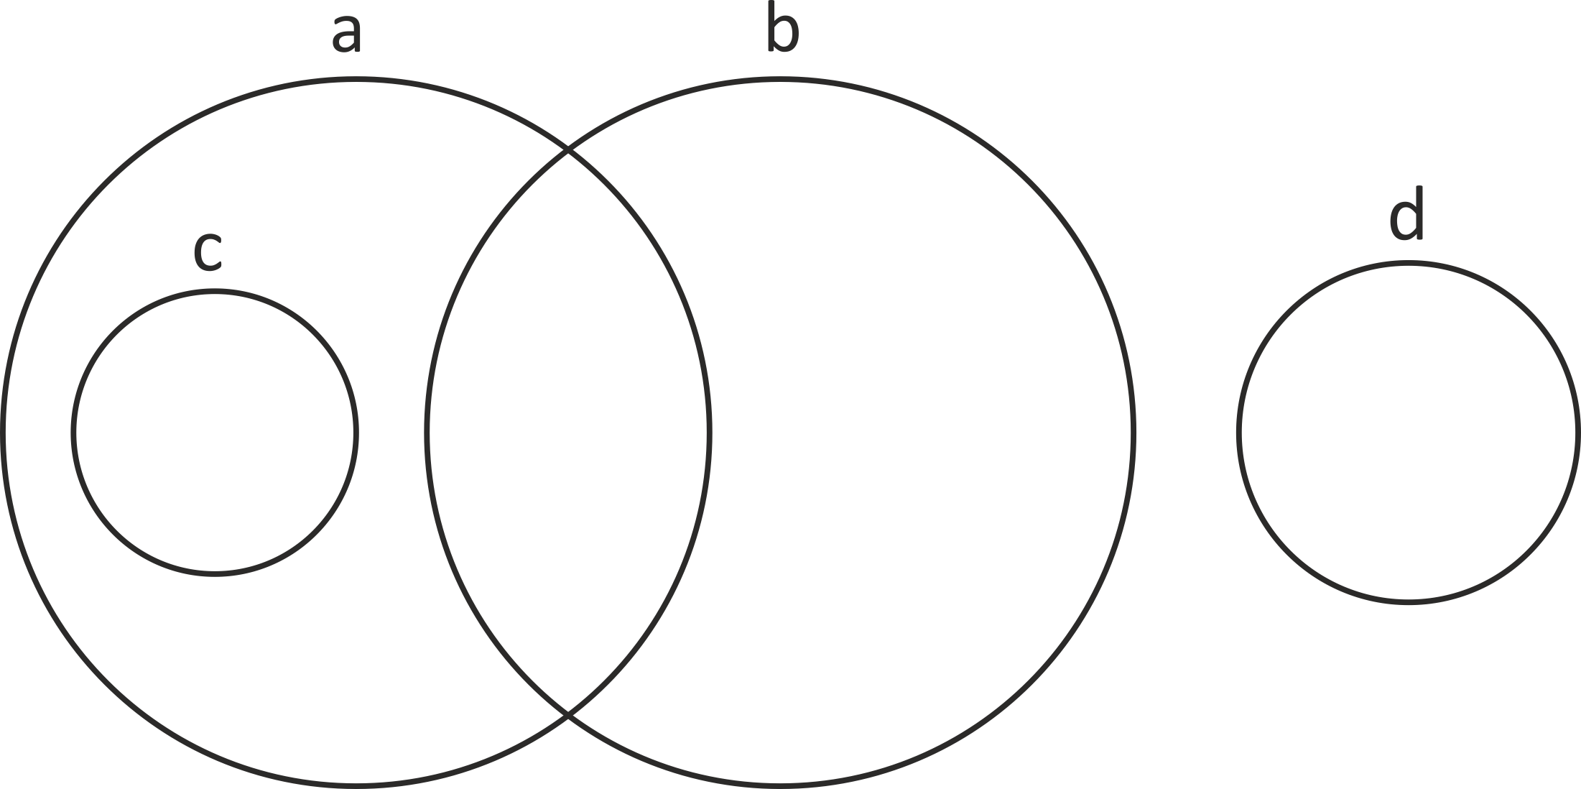
Euler Diagram
Venn Diagram

Slide 57
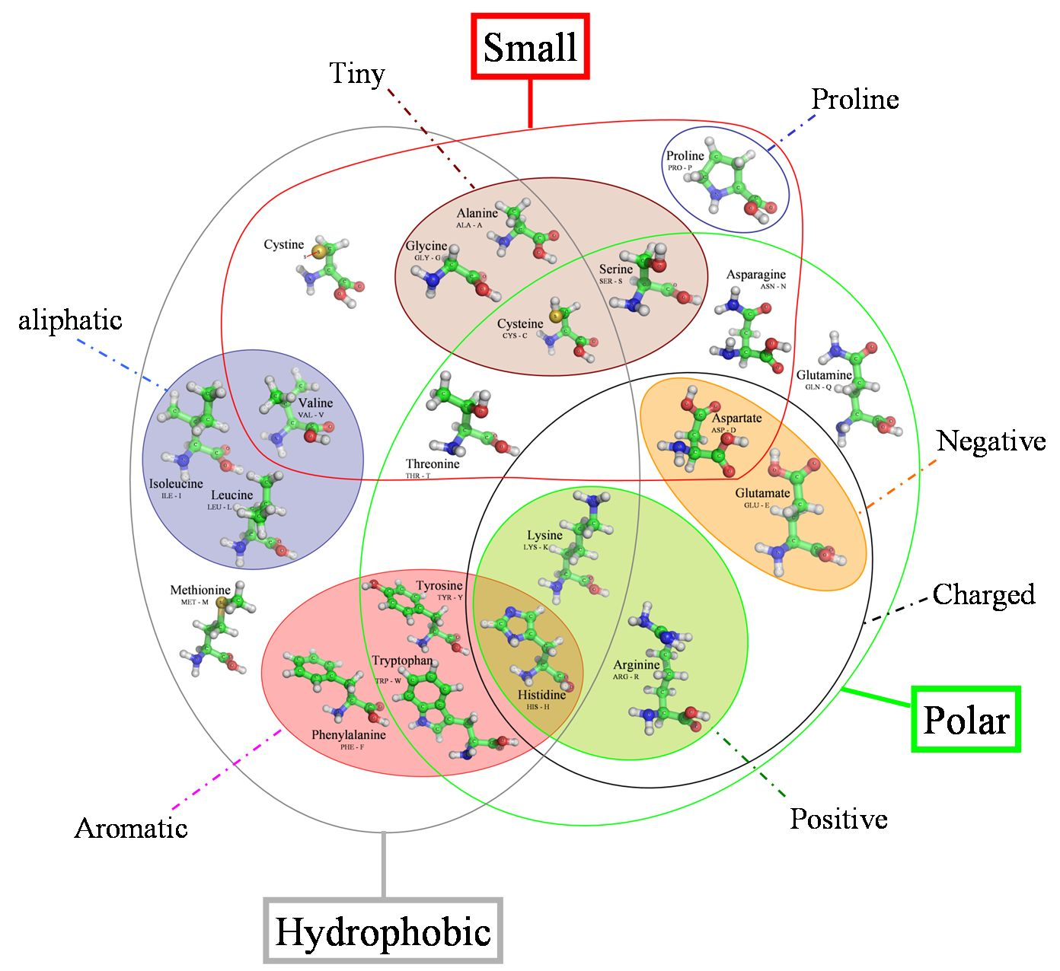

Euler Diagram
Amino Acid Properties
Alexei Podtelezhnikov. (2008, April) Proteins and DNA.

Slide 58
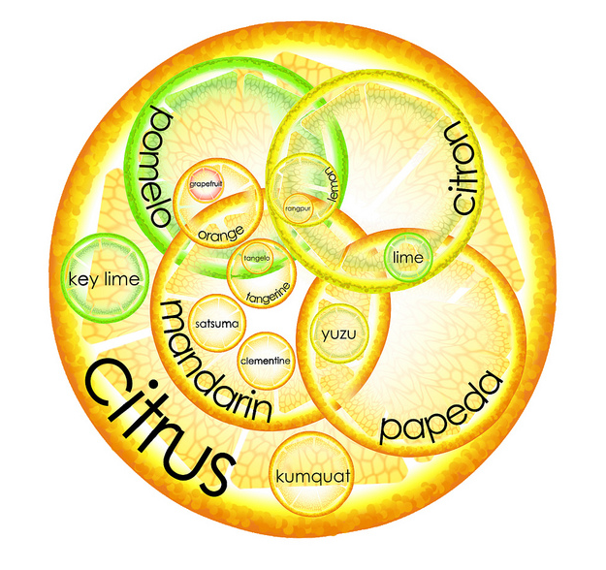

What is
an orange?
http://foter.com/venn-diagram/

Slide 59
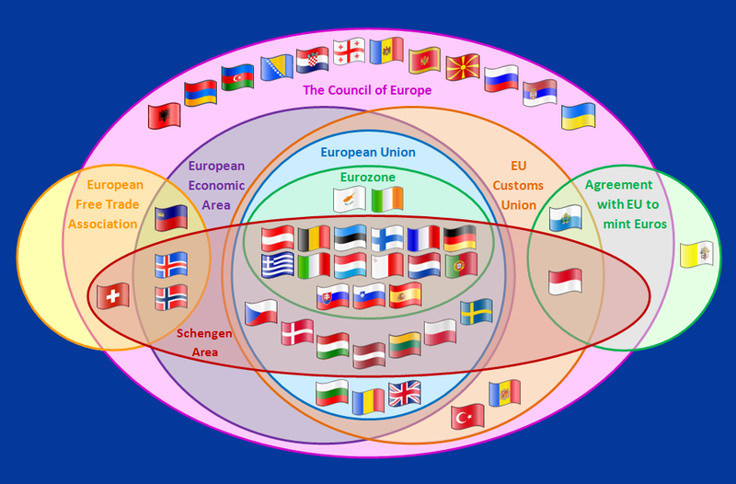

Supranational European Bodies
http://en.wikipedia.org/wiki/File:Supranational_European_Bodies.png

Slide 60
Supranational European Bodies
http://en.wikipedia.org/wiki/File:Supranational_European_Bodies.png

Slide 61
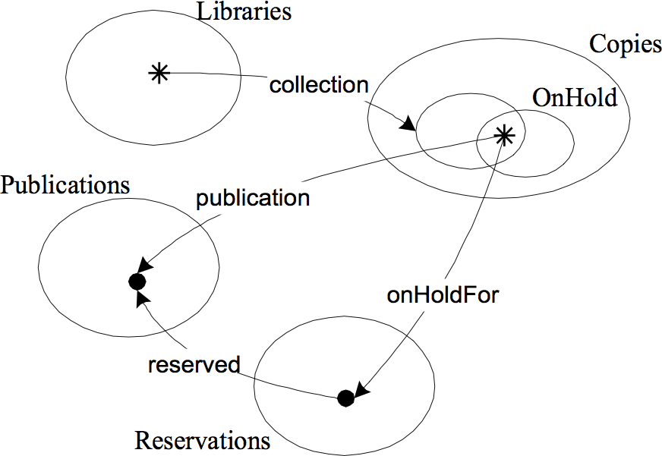
A Library System
John Howse, Fernando Molina, John Taylor, Stuart Kent, Joseph Yossi Gil (2001).
Spider diagrams: A diagrammatic reasoning system.

Slide 62
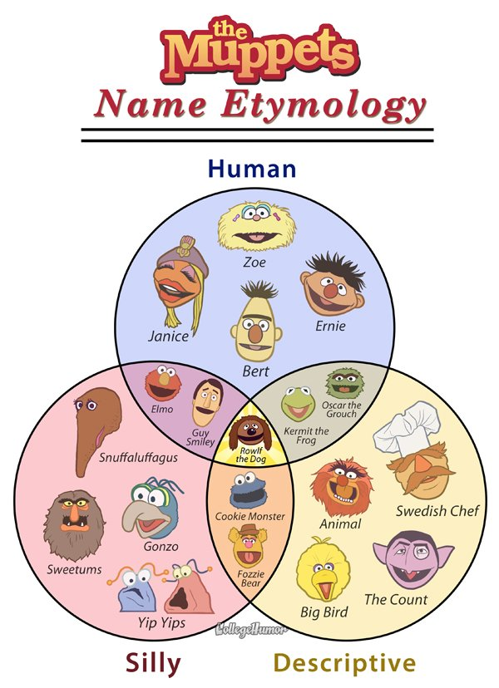
http://flowingdata.com/2010/09/10/the-muppets-name-etymology/

Slide 63
An effective Euler diagram
satisfies a number of aesthetic criteria

Slide 64
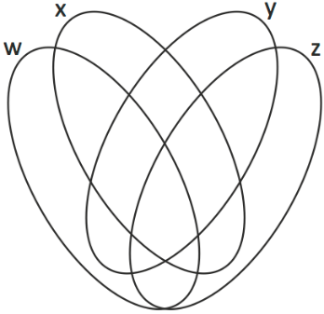

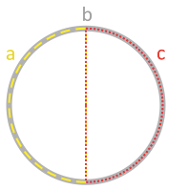
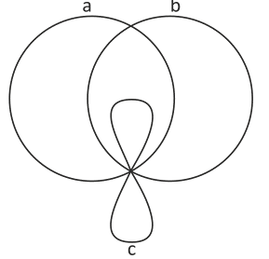
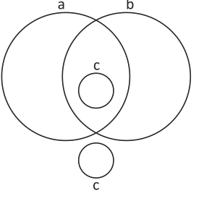

Do
show precisely the
required regions
use highly
symmetric curves
use circles
a
b
c
a b ac
Do not
use non-simple
curves
use >1 curve
for each set
use concurrent
curves
a
b
a
b
b
a
c
c
c
c

Slide 65
An effective Euler diagram
satisfies a number of aesthetic criteria
but …
drawing such a diagram is not always possible

Slide 66
InfoVis
x
VA
SciVis
InfoVis
Visual Analytics (VA)
SciVis

Slide 67
InfoVis
InfoVis
VA
SciVis
VA
SciVis
InfoVis
Visual Analytics (VA)
SciVis

Slide 68
An effective Euler diagram
satisfies a number of aesthetic criteria
but …
drawing such a diagram is not always possible
so…
different automatic drawing techniques for different aesthetic criteria

Slide 69
Euler Diagram Embedder
[Rodgers et al., 2008]
iCircles
[Stapleton et al., 2012]
InfoVis
InfoVis
VA
SciVis
VA
SciVis
InfoVis
Visual Analytics (VA)
SciVis

Slide 70
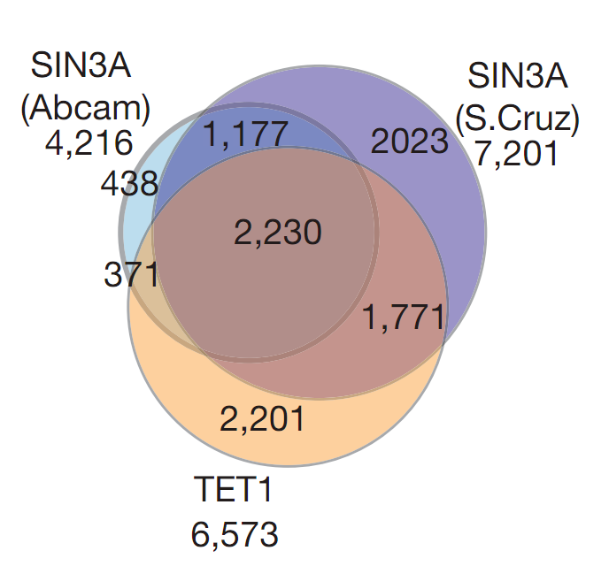
Overlap between TET1 and SIN3A target genes (FDR , 0.01)
K. Williams, J. Christensen, M. T. Pedersen, J. V. Johansen, P. A. C. Cloos, J. Rappsilber, and K. Helin, "TET1 and hydroxymethylcytosine in transcription and DNA methylation fidelity," Nature, vol. 473, no. 7347, pp. 343-348, May 2011, doi:10.1038/nature10066.

Slide 71
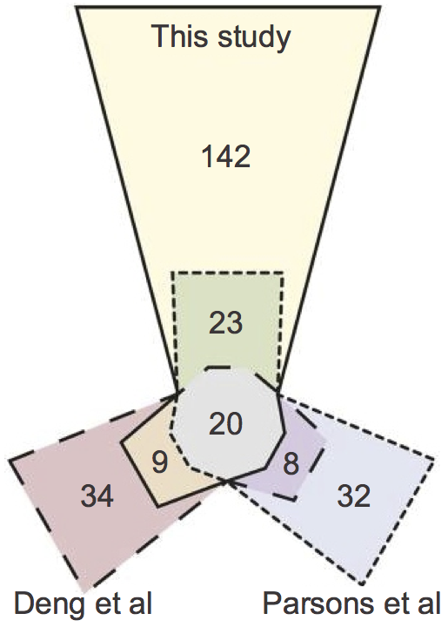


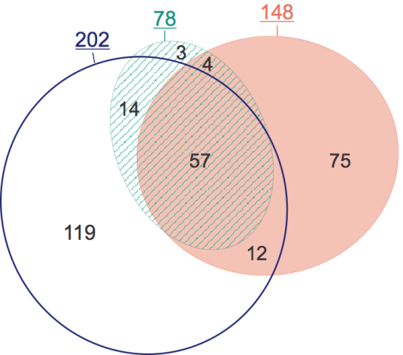

Venn Diagram Plotter
[Littlefield & Monroe]
DrawEuler
[Chow & Ruskey, 2005]
[Micallef et al., 2014]

Slide 72
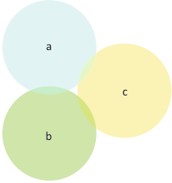


a=500, b=500, c=500, ab=5, ac=5, bc=5, abc=5
missing abc
all regions
a
a
b
c
b
c
venneuler
[Wilkinson, 2012]
3 Circle Venn
[Chow & Rodgers, 2005]
incorrect
set relations
incorrect set relation cardinalities

Slide 73
Cardinalities directly proportional to …
area
number of glyphs

Slide 74
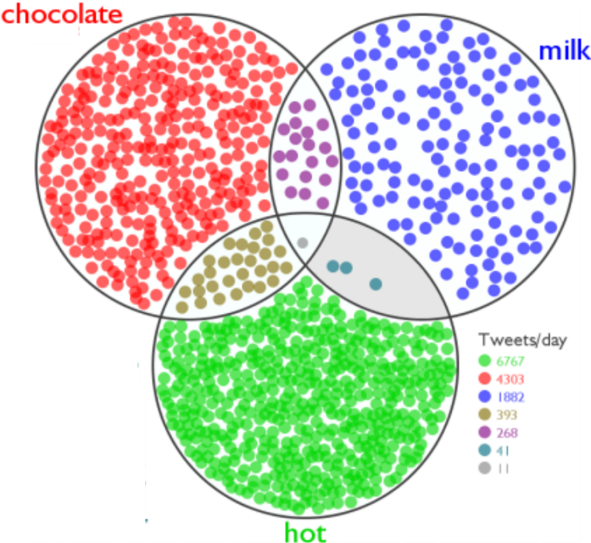


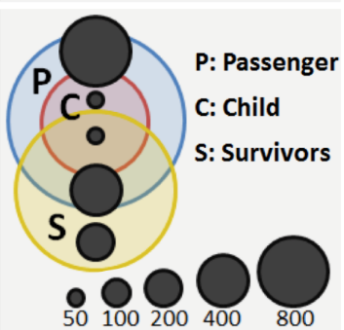
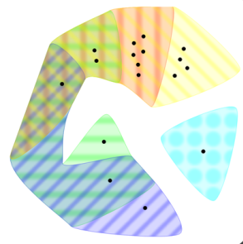
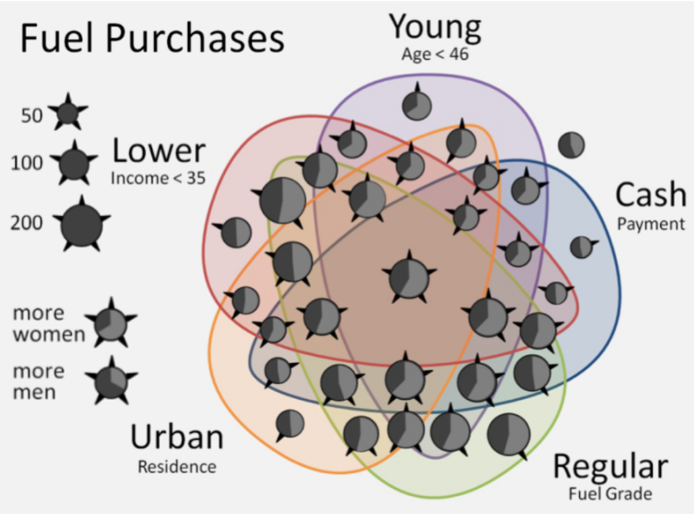
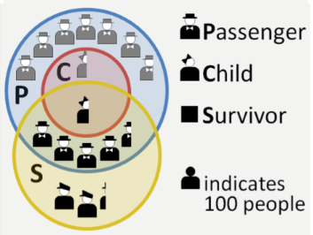
[Micallef et al., 2012]
[Clark, 2008]
EulerView
[Simonetto, 2012]
[Brath, 2012]

Slide 75
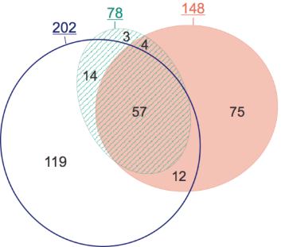





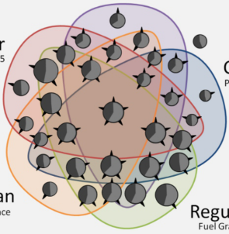
In summary …
show only required set relations
show unwanted set relations
show set relation cardinalities
InfoVis
VA
SciVis
InfoVis
VA
SciVis
InfoVis
VA
SciVis

Slide 76


In summary …
show only required set relations
show unwanted set relations
show set relation cardinalities
InfoVis
VA
SciVis
InfoVis
VA
SciVis
InfoVis
VA
SciVis

Slide 77
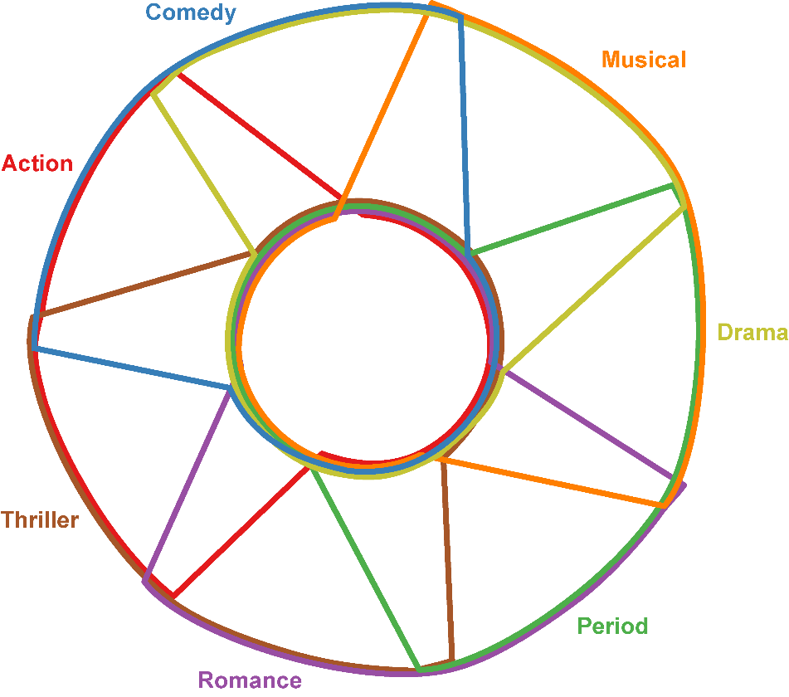
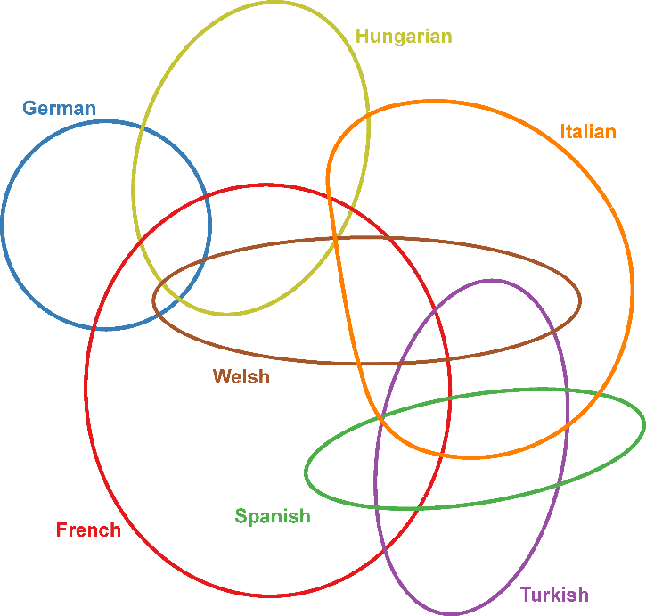






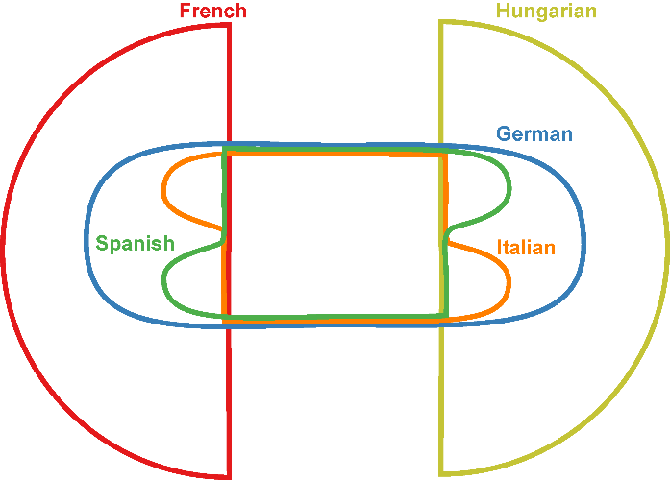
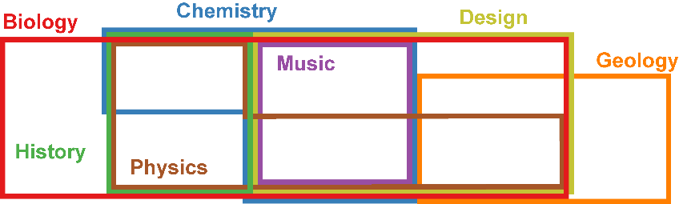
InfoVis
Diagrams
VA
ToD

Slide 78
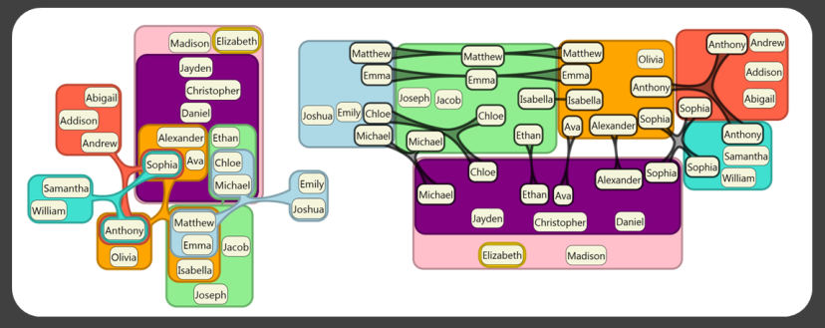
2 Euler Diagram Variants

Slide 79
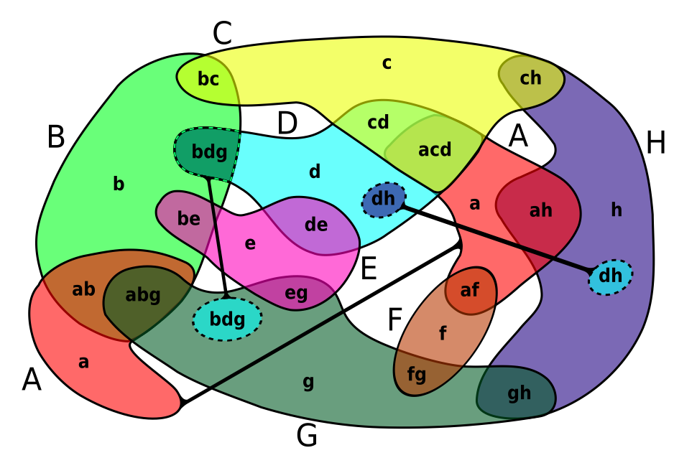
[Simonetto et al., 2008]
A
A
A

Slide 80
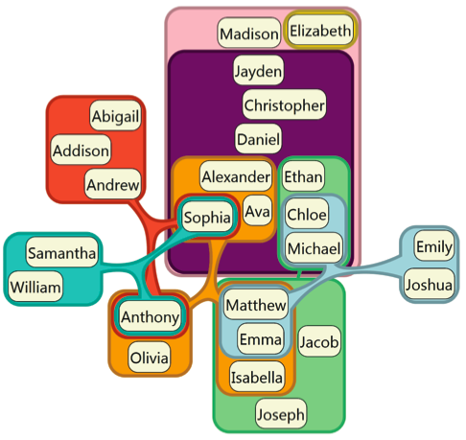
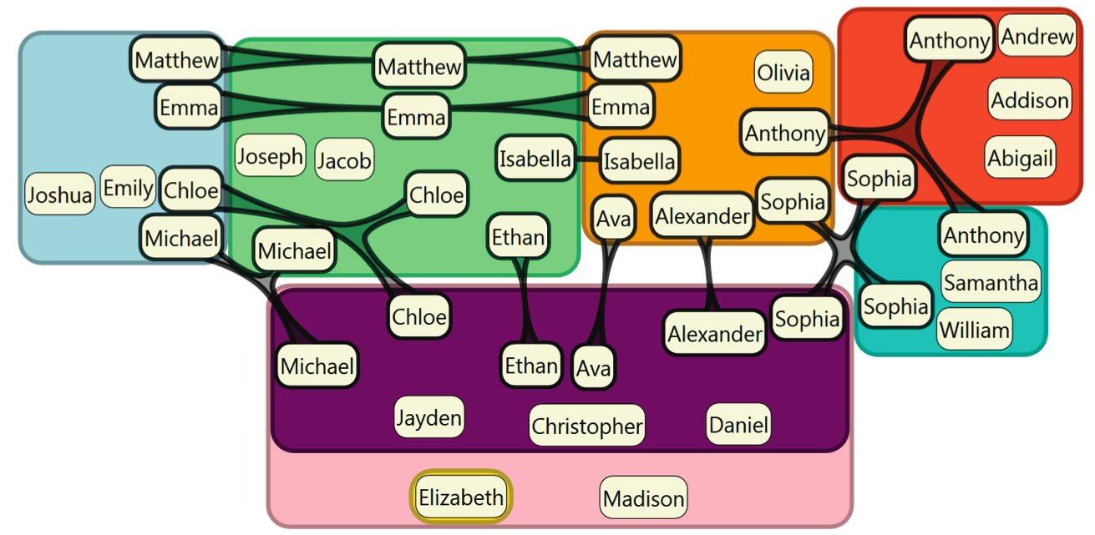
[Henry Riche & Dwyer, 2010]
ComED
Compact Rectangular Euler Diagram
DupED
Euler Diagram with
Duplications

Slide 81


[Henry Riche & Dwyer, 2010]
ComED
Representing …
frequently used words in
10 plays by Shakespeare
DupED

Slide 82


Slide 83


Missing Pieces
Fan Diagrams
[Koshman et al., 2006]
[Kim et al., 2007]

Slide 84





In summary …
use edges
split set into components
split set into components
use a concentric layout

Slide 85

In summary …

Slide 86

3 Overlays

Slide 87

Overlays
Augmenting set memberships over
table and lists
graphs and networks
bar charts and scatter plots
maps
multiple views
[Collins et al., 2009]

Slide 88



Overlays
Region-based
Line-based
Glyph-based
[Collins et al., 2009]
[Dinkla et al., 2012]
[Itoh et al., 2009]

Slide 89

Region-based Overlays
Bubble Sets
Potential Field
Set elements: ++
Others: −−
Isolines
marching squares
[Collins et al., 2009]

Slide 90

Region-based Overlays
Bubble Sets
[Collins et al., 2009]

Slide 91


Line-based Overlays
LineSets
Kelp Diagrams
[Alper et al., 2012]
[Dinkla et al., 2012]

Slide 92


Line-based Overlays
Connect multiple instances of the same element
Parallel Tag Clouds
Context-Preserving Visual Links
[Collins et al., 2009]
[Steinberger et al., 2011]

Slide 93

Glyph-based Overlays
Icons
findaproperpub.co.uk

Slide 94


Glyph-based Overlays
Coloured glyphs
BiblioViz
multiple-category graphs
[Chen 2006]
[Itoh 2009]

Slide 95



Hybrid Overlays
Lines + Regions
Lines + Glyphs
Regions + “Glyphs”
(texture)
[Meulemans et al., 2009]
[Dinkla et al., 2012]
[Wikimedia]

Slide 96

KelpFusion (Lines + Regions)
Bubble Sets
KelpFusion
Kelp Diagrams
[Collins et al., 2009]
[Meulemans et al., 2009]
[Dinkla et al., 2012]

Slide 97


KelpFusion (Lines + Regions)
Bubble Sets
KelpFusion

Slide 98


Overlays - Summary
Region-based
Line-based
Glyph-based

Slide 99


people who understand
venn diagrams
people who don’t

Slide 100

4 Node-Link Diagrams

Slide 101
Node-link Diagrams
A bipartite graph G = (V1 U V2, E)
V1 -> Elements
V2 -> Sets
E -> Memberships
Elements
Sets

Slide 102


Node-link Diagrams
Jigsaw
Biological Networks
[Stasko et al., 2007]
[Schulz et al., 2008]

Slide 103


Node-link Diagrams
Anchored Maps
PivotPaths
[Misue, 2006]
[Dörk et al., 2012]

Slide 104


Node-link Diagrams
Circos
Radial Sets
[Krzywinski, 2009]
[Alsallakh et al., 2013]

Slide 105



Node-link Diagrams - Summary

Slide 106

5 Matrix-based Techniques

Slide 107

Matrix-based Techniques
Element-set memberhip matrix
e.g.
100 elements x 12 sets

Slide 108

Matrix-based Techniques
ConSet
[Kim et al., 2007]

Slide 109

Matrix-based Techniques
Matrix Reordering
[Bertin 1981]

Slide 110

Matrix-based Techniques
Frequency Grids
[Micallef et al., 2012]

Slide 111

Matrix-based Techniques
OnSet (PixelLayers)
[Sadana et al., 2013]

Slide 112

OnSet (PixelLayers)
[Sadana et al., 2013]

Slide 113


Matrix-based Techniques
Overlap/ Similarity Matrix
KMVQL
[Huo 2008]

Slide 114






Matrix-based Techniques - Summary

Slide 115

6 Aggregation-based Techniques

Slide 116


Aggregation-based Techniques
Bar Chart with Redundancy
Set‘o‘gram
[Alsallakh et al., 2013]
[Freiler et al., 2008] Image by Sean McKenna

Slide 117


Aggregation-based Techniques
Double Decker Plot
Set Membership Tree
[Hoffman et al., 2001]
[Kosara, 2007]

Slide 118


Aggregation-based Techniques
Mosaic Displays
Parallel Sets
[Hartigan & Kleiner, 1981]
[Kosara et al., 2006]

Slide 119


Aggregation-based Techniques
Radial Sets
[Alsallakh et al., 2013]

Slide 120

Aggregation-based Techniques - Summary

Slide 121

7 Scatterplots

Slide 122


Scatterplot-based Techniques
scatter view
cluster view
[Liu et al., 2005]

Slide 123
Scatterplot-based Techniques - Summary

Slide 125



4. Node-Link Diagrams
1. Venn and Euler Diagrams
2. Variants of Euler Diagrams
3. Overlays
6. Aggregation-Based Techniques
5. Matrix-based Techniques
7. Scatterplots

Slide 126
s
Question
Break

Slide 127



Which visualization technique shows
non-member elements of a set?

Slide 128

Which visualization technique allows
comparison of set overlaps ?

Slide 129

Which visualization technique can
show additional attributes ?

Slide 130
Over
Break

Slide 131
Comparison

Slide 135
1 Euler and Venn Diagrams
2 Euler Diagram Variants
3 Overlays
4 Node-link Diagrams
5 Matrix-based Techniques
7 Scatterplot-based
6 Aggregation-based Techniques

Slide 136








The Main Focus
sets
elements

Slide 137



Tasks
Elements
Sets & Set Relations
Element Attributes

Slide 138


Slide 139

Fully supported task
Partially supported task
Supported task through interaction

Slide 140
v
v
v
v
v
v

Slide 141








InfoVis
v
Diagrams
Find elements belonging
to a specific set
VA
v
v
ToD
Find sets containing
a specific element
Find elements based on
their set memberships
Find elements with a specific
set membership degree
v
v
v

Slide 142



v
Analyze
inclusion relations
v
v
Analyze
inclusion hierarchies
Analyze
exclusion relations
Analyze
intersection relations
v
v
v

Slide 143



v
v
v
Analyze set & set
intersection cardinalities
v
v
v

Slide 144



v
Find the attribute values
of a certain element
v
v
Find the distribution of an
attribute in a certain
set or subset
Compare the attribute
values of sets or set
intersections
v
v
v

Slide 145

v
v
v
Analyze & compare
set similarities
v
v
v

Slide 146
v
v
v
v
v
v

Slide 147


- sets
Scalability
least
most
least
most

Slide 148



- elements
Scalability
least
most
least
most

Slide 149
- elements
Scalability
x
N/A
least
most
least
most

Slide 150
?
Question
to Luana

Slide 151



Sets

Slide 152




Slide 153


Slide 154



Slide 155


Slide 156



Slide 157

Attributes

Slide 158




Look at the MATRIX!

Slide 159
Future Challenges

Slide 160
Open Problems
Drawing Euler diagrams
Scalability
The role of ordering
Evaluation
Sets + other data types
Multiple set families
Time-varying set-typed data
Fuzzy and uncertain sets

Slide 161


Drawing Euler diagrams with specific properties
show precisely required regions
?
can be
drawn
…
Sets:
a, b, c, d
Set relations:
a, b, c, ab, ac, bc, ad, acd, bcd, abcd
Generic Tool
symmetric
curves
with circles
with simple
curves
non-concurrent
curves

Slide 162
Scalability
Limit currently at about 50 to 100
What about 1000 sets?
e.g. Persons x Genes
Membership Matrix
Overlap Matrix
Set‘o‘gram

Slide 163
The role of ordering
[Kim et al., 2007]

Slide 164

Evaluation
few empirical user studies
Vis Technique
Tasks
most compare techniques in the same category
and specific context
?
Bubble Sets
LineSets
KelpFusion
[Meulemans et al., 2013]

Slide 165

Sets in context of other data types
Overlays specific for certain data types
Influence element placement to benefit the sets

Slide 166


Sets in context of other data types
Sets in a scatterplot?
Sets in Parallel Coordinates?
sets?
sets?
sets?
sets?
sets?

Slide 167

Comparing multiple set families
[Nikulenkov et al., 2012]

Slide 168


Time-varying set-typed data
2005
2014

Slide 169



Time-varying set-typed data
Changes in sets
Changes in elements
Changes in memberships
Changes in attributes
[van Landesberger et al., 2012]

Slide 170





Fuzzy and uncertain set memberships
[Vehlow et al., 2013]
[Park and Park, 2012]

Slide 171





Possible Opportunities
Interaction
Coordinated multiple views
Small multiples
Hybrid visualizations
Matrix representations
Analytical methods
Special cases and forms

Slide 172
Conclusions
Sets as a data type
Tasks with set-typed data
Visualization techniques
Comparison
Future challenges
Why to think of sets

Slide 173
www.SetViz.net
Software Tools
Online Demos
Videos
Conference Slides
And more…
Supplementary File

Slide 174
Thank you!

Slide 175
Thank you!
Bilal
Alsallakh
Luana
Micallef
Wolfgang
Aigner
Helwig
Hauser
Silvia
Miksch
Peter
Rodgers

